Slide 1

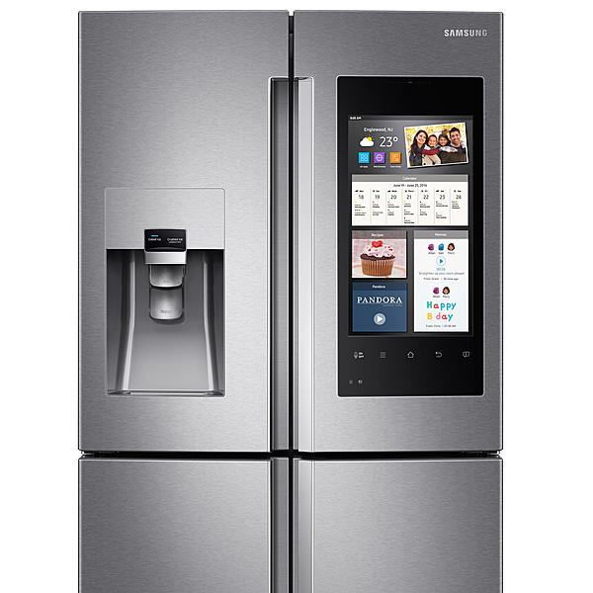


Embedded Systems
ECEN 361

Slide 2
Interprocess Communication
Can be done using shared memory – In most RTOS all memory is available to all processes (in Linux – each process has its own memory space). A global shared memory space can be used to share information
No Information on when the data came in
Must be protected by a mutex semaphore

Slide 3
Interprocess Communication
A Queue is a more elegant solution.
Managed Data Structure
Data timing can be managed (FIFO/FILO)
Protects itself from multiple accesses
Can be used for synchronization

Slide 4
Queue: Task-to-task communication
Scope
How to create a queue
How a queue manages the data it contains
How to send data to a queue
How to receive data from a queue
What it means to block on a queue
The effect of task priorities when writing to and reading from a queue

Slide 5
Queue Characteristics – data storage
A queue can hold a finite number of fixed size data items.
Normally, used as FIFO buffers where data is written to the end of the queue and removed from.
Also possible to write to the front of a queue.
Writing data to a queue causes a byte-for-byte copy of the data to be stored in the queue itself.
Reading data from a queue causes the copy of the data to be removed from the queue.

Slide 6
A Queue is an Object
Queues are objects in their own right
Not owned by or assigned to any particular task
Any number of tasks can write to the same queue and any number of tasks can read from the same queue.
Very common to have multiple writers, but very rare to have multiple readers.

Slide 7
Blocking on Queue Reads
A task can optionally specify a ‘block’ time
The maximum time that the task should be kept in the Blocked state to wait for data to be available from the queue.
It is automatically moved to the Ready state when another task or interrupt places data into the queue.
It will also be moved automatically from the Blocked state to the Ready state if the specified block time expires before data becomes available.

Slide 8
Blocking on Queue Reads
Only one task will be unblocked when data becomes available.
Queue can have multiple readers.
So, it is possible for a single queue to have more than one task blocked on it waiting for data.
The task that is unblocked will always be the highest priority task that is waiting for data.
If the blocked tasks have equal priority, the task that has been waiting for data the longest will be unblocked.

Slide 9
Blocking on Queue Writes
A task can optionally specify a ‘block’ time when writing to a queue.
The maximum time that task should be held in the Blocked state to wait for space to be available on the queue.

Slide 10
Blocking on Queue Writes
Queue can have multiple writers.
It is possible for a full queue to have more than one task blocked on it waiting to complete a send operation.
Only one task will be unblocked when space on the queue becomes available.
The task that is unblocked will always be the highest priority task that is waiting for space.
If the blocked tasks have equal priority, the task that has been waiting for space the longest will be unblocked.

Slide 11
Using a Queue
A queue must be explicitly created before it can be used.
The RTOS allocates RAM from the heap when a queue is created.
RAM holds both the queue data structure and the items that are contained in the queue.
xQueueCreate() API Function
Be used to create a queue and returns an xQueueHandle to reference the queue it creates.

Slide 12
Creating a Queue
Function Prototype
xQueueHandle xQueueCreate(
unsigned portBASE_TYPE uxQueueLength, unsigned portBASE_TYPE uxItemSize);
xQueueLength: The maximum number of items that the queue being created can hold at any one time.
uxItemSize: the size in bytes of each data item that can be stored in the queue.
Return Value:
if NULL is returned, the queue cannot be created as there is insufficient heap memory available for FreeRTOS to allocate the queue data structures and storage.
A non-NULL value returned indicates that the queue has been created successfully. It should be stored as the handle to the created queue.

Slide 13
Writing to a Queue
xQueueSendToBack()
Be equivalent to xQueueSend()
Be used to send data to the back(tail) of a queue
xQueueSendToFront()
Be used to send data to the front (head) of a queue
Please note, never call these two API functions from an interrupt service routine (ISR).
Interrupt-safe versions will be used in their place and described in next chapter.

Slide 14
Reading from the Queue
xQueueReceive()
Be used to receive (consume) an item from a queue. The item received is removed from the queue.
xQueuePeek()
Be used receive an item from the queue without the item being removed from the queue.
Receives the item from the head of the queue.
Please note, never call these two API functions from an interrupt service routine (ISR).

Slide 15
Other Useful Functions
There is a function that can be used to query the number of items that are currently in a queue.
Prototype
unsigned portBASE_TYPE uxQueueMEssagesWaiting (
xQueueHandle xQueue);
Returned value: the number of items that the queue being queried is currently holding. If zero is returned, the queue is empty.

Slide 16
Blocking when receiving from a queue
To demonstrate
a queue being created,
Hold data items of type long
data being sent to the queue from multiple tasks,
Sending tasks do not specify a block time, lower priority than receiving task.
And data being received from the queue
Receiving task specifies a block time 100ms
So, queue never contains more than one item
Once data is sent to the queue, the receiving task will unblock, pre-empt the sending tasks, and remove the data – leaving the queue empty once again.

Slide 17
Blocking when receiving from a queue
vSenderTask() does not specify a block time.
continuously writing to the queue
xStatus = xQueueSendToBack(xQueue, pvParameters, 0);
If (xStatus != pdPASS) {
vPrintString(“Could not send to the queue.\n”); }
taskYIELD();
vReceiverTask() specifies a block time 100ms.
Enter the Blocked state to wait for data to be available, leaves it when either data is available on the queue, or 100ms expires, which should never occur.
xStatus = xQueueReceive(xQueue, &xReceivedValue, 100/portTICK_RATE_MS);
if (xStatus == pdPASS) {
// print the data received
}

Slide 18
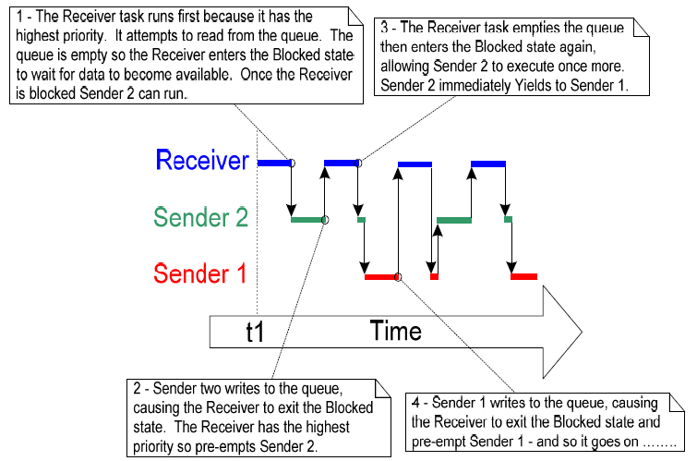
Execution sequence

Slide 19
Working with large data
It is not efficient to copy the data itself into and out of the queue byte by byte, when the size of the data being stored in the queue is large.
It is preferable to use the queue to transfer points to the data.
More efficient in both processing time and the amount of RAM required to create the queue.
But, when queuing pointers, extreme care must be taken.

Slide 20
Working with large data
The owner of the RAM being pointed to is clearly defined.
When multiple tasks share memory via a pointer, they do not modify its contents simultaneously, or take any other action that cause the memory contents invalid or inconsistent
Ideally, only the sending task is permitted to access the memory until a pointer to the memory has been queued, and only the receiving task is permitted to access the memory after the pointer has been

Slide 21
Working with large data
The RAM being pointed to remains valid.
If the memory being pointed to was allocated dynamically, exactly one task be responsible for freeing the memory.
No task should attempt to access the memory after it has been freed.
A pointer should never be used to access data that has been allocated on a task stack. The data will not be valid after the stack frame has changed.
Notes:
What data are allocated on a task stack.

